Slide 1
Creating test items
Michelle Hoogenhout

Slide 2
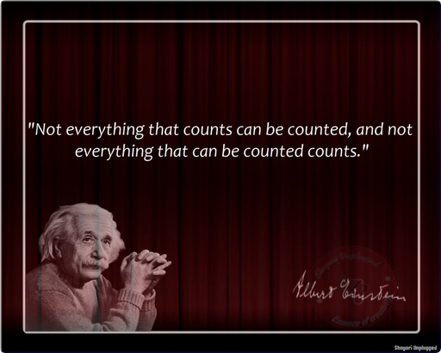

Slide 3
Specifying the aim of the measure
The aim is what you want to achieve with your test
Can have different aims for the same construct, e.g., stress
To measure how someone reacts to stress?
To measure how much stress a person is experiencing at the moment?

Slide 4
Other considerations when specifying the aim
Are we going to use our questionnaire for screening purposes or in-depth assessment?
Screening
Less items & content covered
Quick & easy to administer
Detailed assessment
More items & content covered
More reliable, but more time-consuming
Might require special training
What decisions can we make based on a score on the test?
e.g., we can’t say that someone who reacts badly to stress experiences a high amount of stress

Slide 5
Define the concept

Slide 6
Decide on purpose of the test
Aim = what exactly are we going to measure?
Purpose = what are we going to use scores on this test for?

Slide 7
Decide on item format
Open-ended items
No limitations on the responder
Describe how you normally behave when you have to confront a colleague at work [example of work stressor]
Forced-choice items
MCQs; True-False
When I am in a situation at work where I need to confront a colleague at work, I usually:
I make myself sick worrying about how to approach it
I try not to let it disrupt my day
Feel mild anxiety

Slide 8
Forced-choice items (cont).
Likert-type items
On a scale of 1-7, rate how stressful it is for you to confront a colleague at work:
1 2 3 4 5 6 7
(Not at all stressful) (somewhat stressful) (extremely stressful)
Two-item forced choice
I find confronting a colleague at work
Not at all stressful
Extremely stressful

Slide 9
Sentence-completion items
“The most important thing in life is ____”
“In situations of extreme stress I _____”

Slide 10
Decide on test length
Compliance lower when item numbers are higher
People get fatigued, bored, etc.
Need at least more items in initial version than final version
You will discard bad items
Do you need an equal number of items on different parts of the test?

Slide 11
Decide how items will be scored
And stored!
Notes:
Likely to be a lot more behavioural reactions to stress, so need to measure in more detail. Physiological reactions comprise a finite list of responses.

Slide 12
Writing the items
See Designing Questions to Be Good Measures
http://wilderdom.com/research/articles/DesigningQuestionsToBeGoodMeasures.html
Use clear wording
Use appropriate vocabulary – don’t try to be fancy
Items should be understood the same way by everyone
Avoid double negatives
e.g., “I do not never get stressed out around exam time.”
e.g., “None of the answers in the MCQ weren’t correct.”
Include pictures if writing for people with low literacy

Slide 13
Make sure that all options are covered in multiple-choice responses
Make sure that respondent can only select one option

Slide 14
Reviewing the items
Expert panel :
Cultural/linguistic/gender appropriateness of items; wording of items; any bias in items etc.
Focus groups:
Groups of people from the target population comment on test and test items

